Slide 1

Sorting Algorithms
Presented by Prof. Goble
Dickinson College Spring 2024

Slide 2
Known sorting algorithms?

Slide 3
Selection Sort
We describe our list in two parts
The sorted section
The unsorted section
This algorithm works by repeatedly selecting the smallest (or largest) element from the unsorted portion of the list, and moves it into the sorted portion of the list

Slide 4

Section Sort
Best Case: $Ω(n^{2})$
Worst Case: $O(n^{2})$
Average Case: $Θ(n^{2})$

Slide 5

Section Sort
Best Case: $Ω(n^{2})$
Worst Case: $O(n^{2})$
Average Case: $Θ\left(n^{2}\right)$
Why?

Slide 6
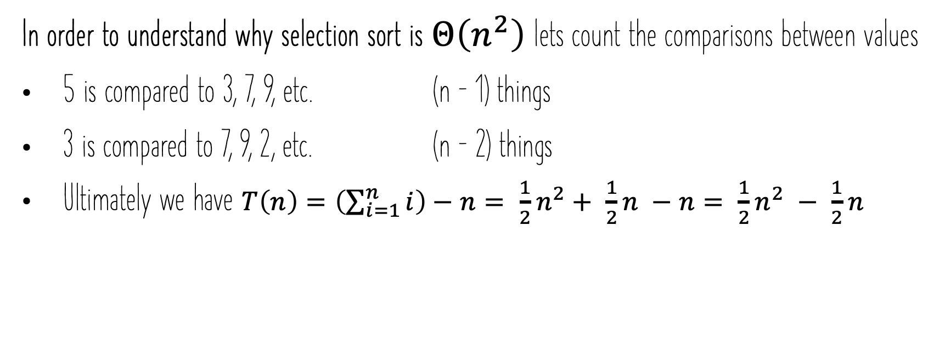
Selection Sort
In order to understand why selection sort is $Θ\left(n^{2}\right)$lets count the comparisons between values
5 is compared to 3, 7, 9, etc. (n – 1) things
3 is compared to 7, 9, 2, etc. (n – 2) things
Ultimately we have $T\left(n\right)=\left(\sum_{i=1}^{n}{i}\right)−n= \frac{1}{2}n^{2}+ \frac{1}{2}n −n= \frac{1}{2}n^{2} − \frac{1}{2}n$

Slide 7
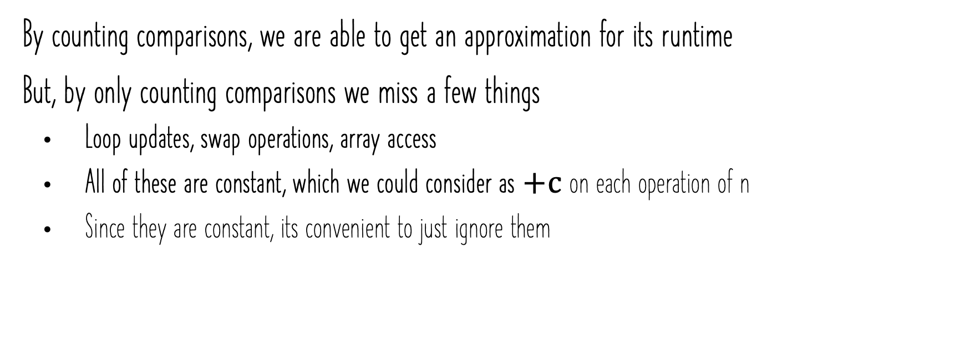
Selection Sort
By counting comparisons, we are able to get an approximation for its runtime
But, by only counting comparisons we miss a few things
Loop updates, swap operations, array access
All of these are constant, which we could consider as $+c$on each operation of n
Since they are constant, its convenient to just ignore them

Slide 8
Sorting Terminology
Stable sort: A sorting algorithm is said to be stable if it preserves the relative order of equal elements
If two elements have the same value, the one that appeared earlier in the input will also appear earlier in the sorted output
In place sort: A sorting algorithm is in place if it uses constant extra space for producing the output, meaning it doesn’t create a new array/list to store the sorted elements

Slide 9
Insertion Sort
Assume the first part of the list is in sorted order
For each additional element, swap it left until it is in it’s proper place
Both stable (if we don’t swap when keys are equal) and inplace

Slide 10
Insertion Sort
Best Case:
Worse Case:
Average Case:

Slide 11

Insertion Sort
Best Case: Elements are already in order
$T\left(n\right)=1+1+1+ …+1=\left(n −1\right)$
$Ω(n)$

Slide 12

Insertion Sort
Best Case: Elements are already in order
$T\left(n\right)=1+1+1+ …+1=\left(n −1\right)$
$Ω(n)$
Worse Case: Elements are in reverse order
$T\left(n\right)=1+2+3+ …+\left(n −1\right)= \sum_{i=1}^{n−1}{i}$
$O(n^{2})$

Slide 13
Insertion Sort
Whenever the best-case and worst-case are different it is worth determining the average cases
Average Case: When Values are uniformly distributed
We expect that for any element i, half the values to the left of i are smaller and half are larger

Slide 14
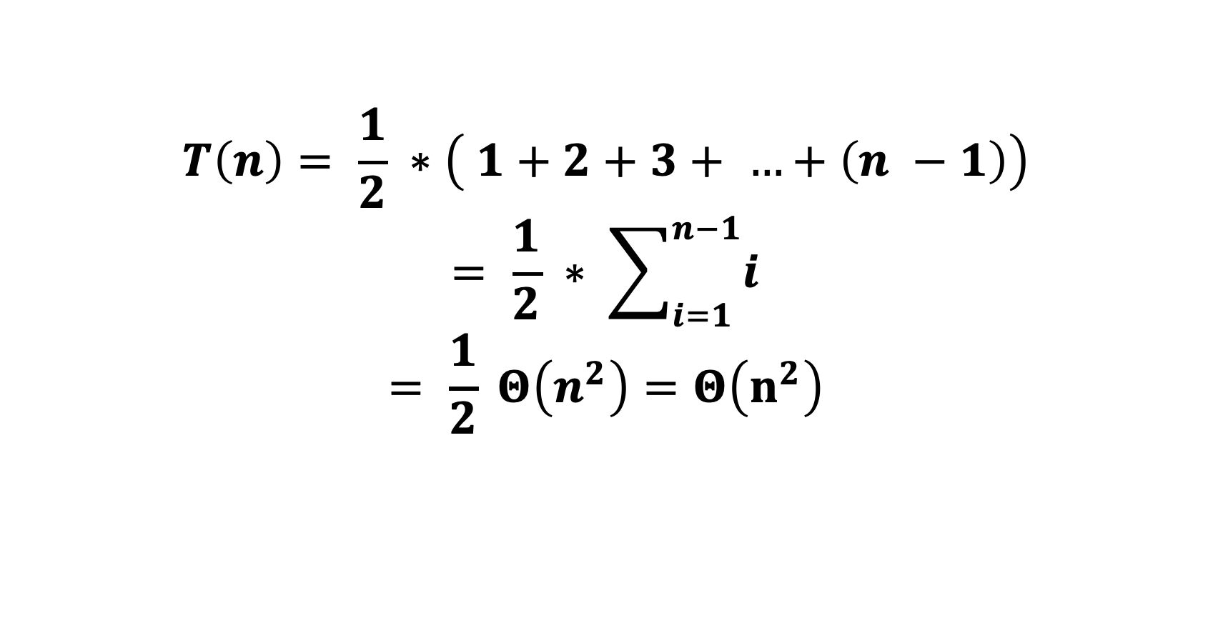
Insertion Sort
$$T\left(n\right)= \frac{1}{2} ∗\left( 1+2+3+ …+\left(n −1\right)\right)$$
$$= \frac{1}{2} ∗ \sum_{i=1}^{n−1}{i}$$
$$= \frac{1}{2} Θ\left(n^{2}\right)=Θ\left(n^{2}\right)$$

